Slide 1
Planning Question 4 – imagine two articles on Bieber
4. For this question, you need to refer to the whole of Source A, together with the whole of Source B.
Compare how the writers convey their different perspectives on Justin Bieber.
In your answer, you could:
consider their different perspectives on the disasters
Compare the methods the writers use to convey their different perspectives
support your response with references to both texts.
[16 marks]
Language Features and Structural Techniques

Slide 2
Planning Question 4
Break down the topic where you can:
Each sub-topic can be a paragraph
You will struggle to write four paragraphs just about Justin Bieber in general.
Music
Personality
Justin Bieber
Fashion Sense
Criminal Record

Slide 3
Planning Question 4 – Paragraph Plan
SOURCE A
SOURCE B
Perspective 1
How does this perspective on a similar topic differ in Source B?
What Language or Structural Feature shows most clearly what Writer A’s perspective is?
What Language or Structural Feature shows clearly what Writer B’s perspective is?
Summarise differences
Now Repeat for Perspective 2

Slide 4
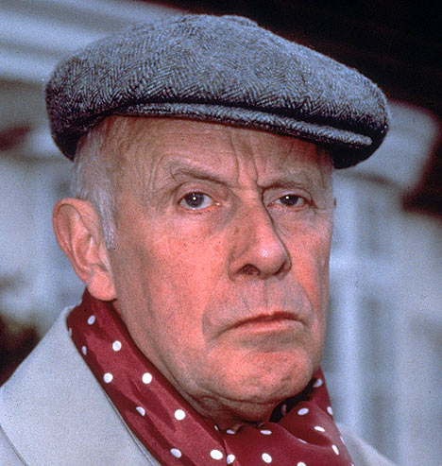

Planning Question 4 – Paragraph Plan – Justin Bieber’s Music
SOURCE A
SOURCE B
Hates Justin Bieber’s music
Loves Justin Bieber’s music
We can see from his use of the words ‘terrible,’ ‘abysmal’ and ‘cacophony’ in a list of three that Writer A has a negative perspective on Bieber’s music.
Writer B’s use of the adjective ‘delicious’ in a short, single-word sentence clearly shows her positive perspective on Bieber’s music.
Their perspectives on his music are opposed
Now repeat in a new paragraph for another topic; e.g., his personality.

